Slide 1
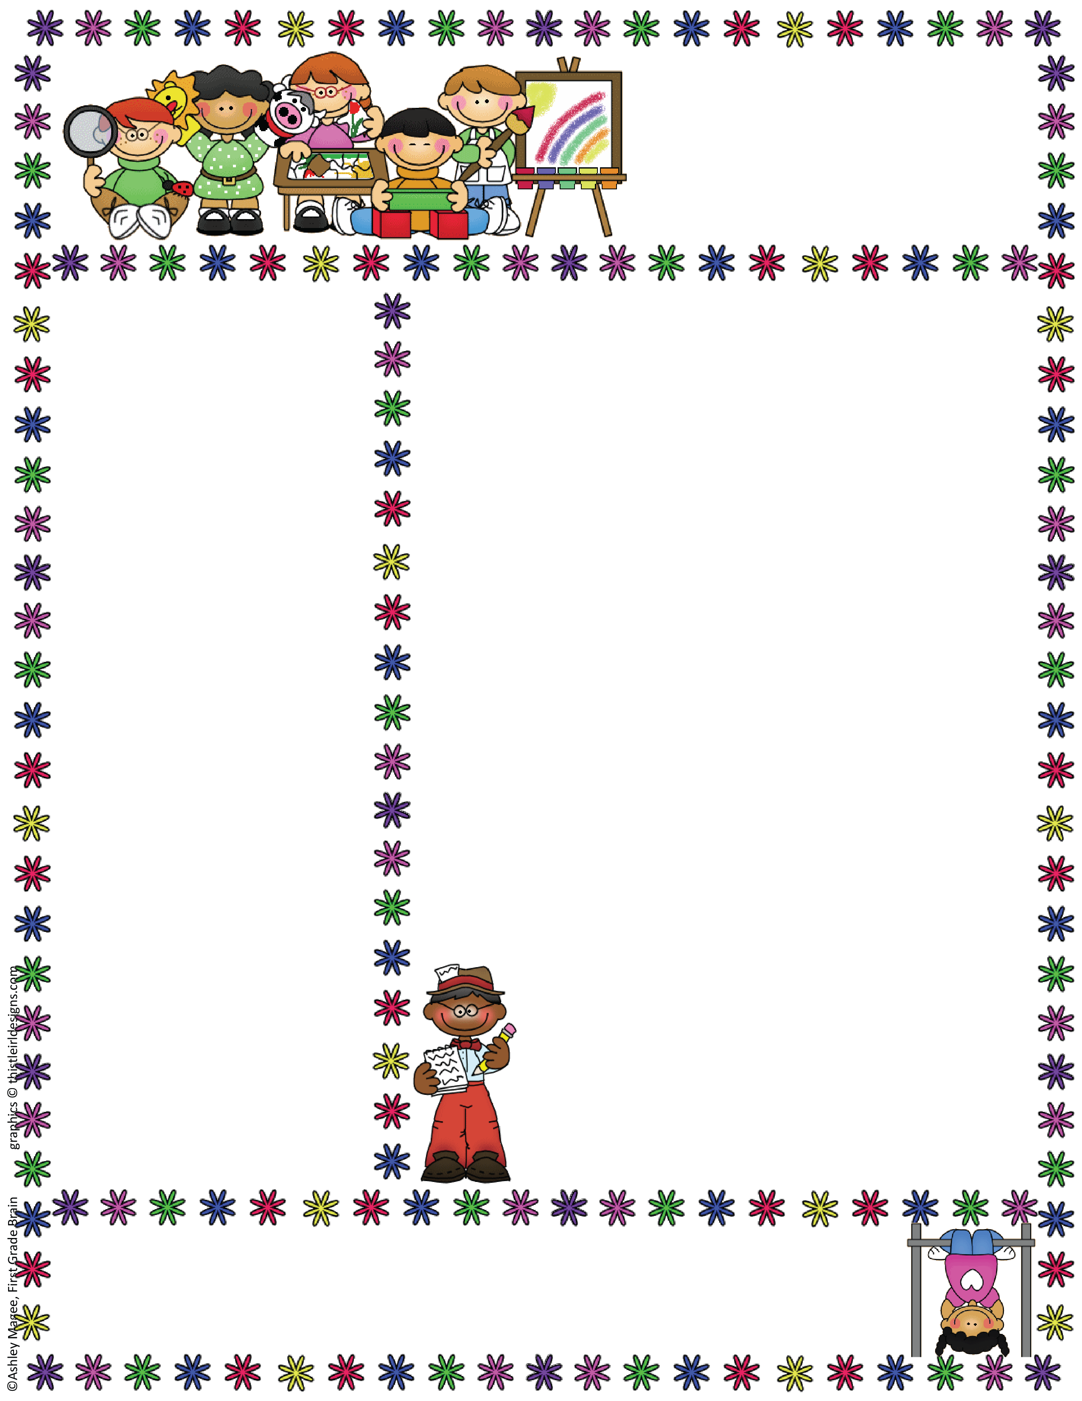
Miss Topping P2/1
Termly Class Newsletter
October 2022
Student Teacher
We are pleased to welcome Miss Charnley to work with the class throughout November. Miss Charnley is studying at Edinburgh University, and will be planning and delivering learning across the curriculum with support and guidance from Miss Topping.The children have already made Miss Charnley very welcome and has some very fun and exciting learning opportunities planned for the class.
Learning Through Play
Our first shared area of interest this term is autumn, which captivated children’s attention as they noticed the change in season while playing outdoors. We had wonderful experiences at West Lothian College to deepen this interest, including den building, model making and painting in their special forest garden. We cannot wait to go back again for a second visit, when the college students will have follow up activities planned specially for the class . Before this back at school we will have the chance to explore natural, seasonal materials in the classroom and garden, and will do autumnal crafts and process arts. We will connect our knowledge of seasons to our maths learning about time, helping us to further understand our world.
Children love to link their home and classroom learning, so when your family are out and about this autumn please chat about the changes that the season has brought. Children could even collect treasures such as leaves and conkers to bring to our exploration station.
Our School Rules:
Ready To Learn, Respectful, Safe

Slide 2
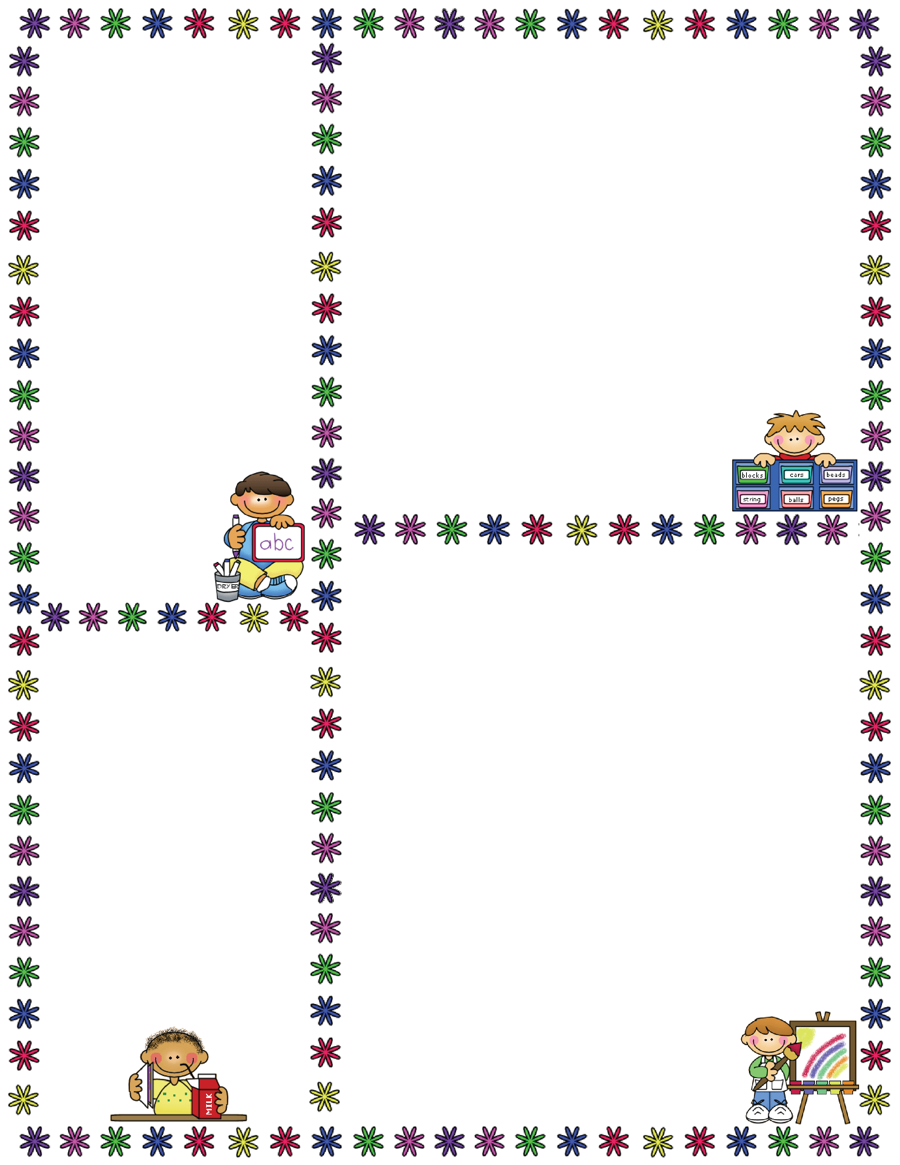
Dates For Your Diary:
Tuesdays and Thursdays: PE (wear joggers/ leggings with school polo shirt)
Fridays: Big Bedtime Read swap (bring clear borrowed book bag to exchange)
Tuesday 8th November: Trip to West Lothian College
Monday 14th – Friday 19th November: Scottish Book Week- more details soon
Friday 23rd December:
Last Day of Term
Literacy
This term our focus is on persuasive texts. We will be learning to give reasons when we write and speak about lots of different topics. If you find yourself being talked into something by your child over the coming weeks, I can only hope it is because they wow you with their use of the word “because,” and give lots of powerful arguments! I am sure they will only use their new-found persuasive powers for good of course!
Please continue to practice reading, writing and tricky words at home in short bursts,
as often as you can. This really helps your
child progress, and can be a fun family
activity done through games and crafts.
Numeracy and Maths
We are learning addition and subtraction this term. P1s will be learning to understand the basic concepts and the symbols used, and building their confidence and accuracy in working with numbers up to 20. An important part of this is recognising number patterns such as dice, dominoes, and finger counting, so playing board games at home is a great support. P2s will build on their existing knowledge, becoming more confident with number sentences for addition and subtraction of bigger numbers. They will learn strategies to help them work efficiently and accurately, such as breaking numbers into tens and ones.
We will also be learning how to read
clocks and calendars as we explore time.
Supporting Your Child’s Learning
You will receive a vocabulary sheet of words which will be used this term in our learning. Talking about these words at home will help your child grasp new ideas more easily.
Please ensure homework bags are checked regularly, and brought to school every day.
Thank you for your continued support.
Miss Topping

Slide 3

Vocabulary
Please talk about and use these words at home with your child to help them engage with the learning in class.
Thank you for your continued support.
Miss Topping
Addition and Subtraction Vocabulary
add | take away | subtract
plus | give | minus
more | less | equals
Time Vocabulary
time | seasons | hours
minutes | seconds | weeks
months | days | years
after | before | first
last | next | second
third | o’clock | half past
Persuasive Vocabulary
because | I believe | important
reason | persuade | argument

